Slide 1
TN3125
Information and Computation
Lecture 1
3 – Properties of entropy

Slide 2
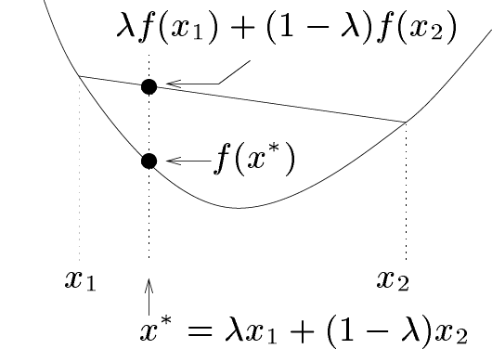
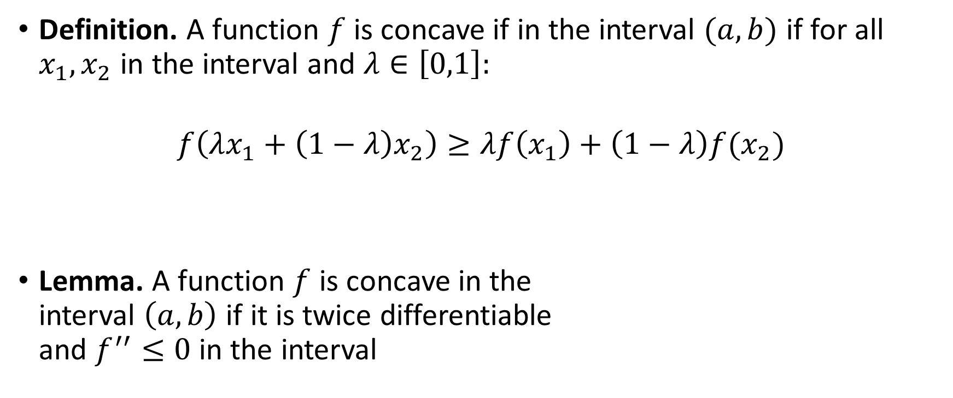
Concave functions
Definition. A function $f$ is concave if in the interval $(a,b)$ if for all $x_{1},x_{2}$ in the interval and $λ∈\left[0,1\right]:$
$$f\left(λx_{1}+\left(1−λ\right)x_{2}\right)≥λf\left(x_{1}\right)+\left(1−λ\right)f(x_{2})$$
Lemma. A function $f$ is concave in the
interval $\left(a,b\right)$ if it is twice differentiable
and $f^{′′}≤0$ in the interval

Slide 3

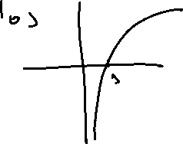
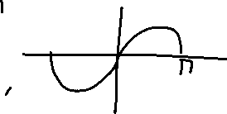

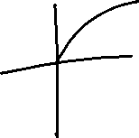

Slide 4
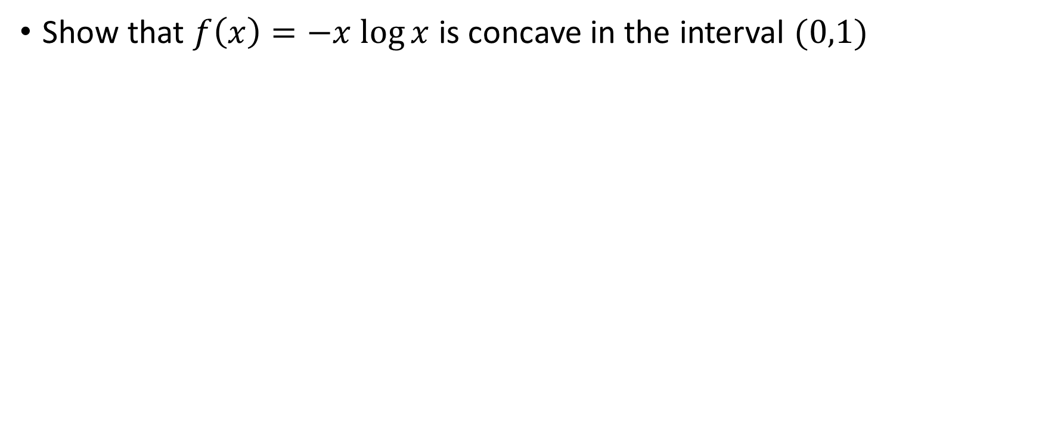

Exercise
Show that $f\left(x\right)=−x log⁡x$ is concave in the interval $(0,1)$

Slide 5
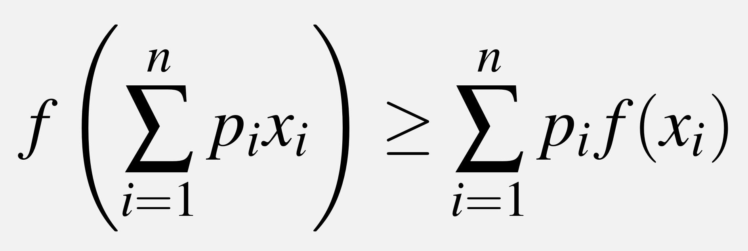
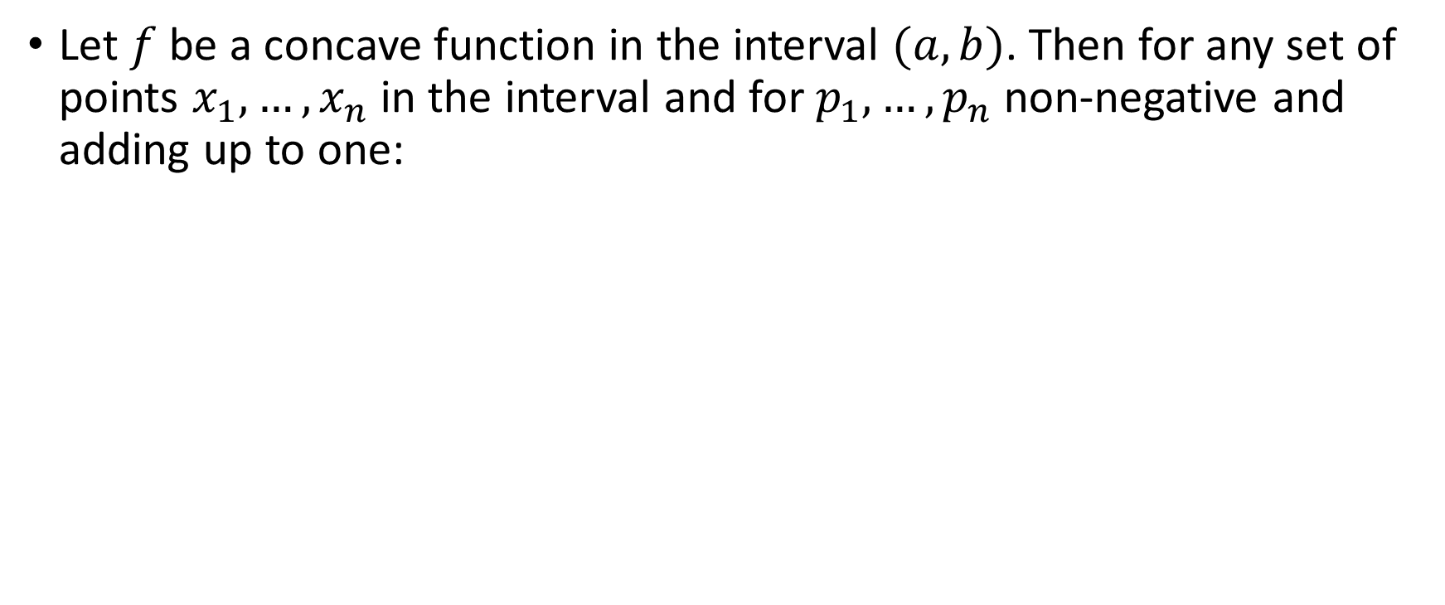
Jensen’s theorem
Let $f$ be a concave function in the interval $(a,b)$. Then for any set of points $x_{1},…,x_{n}$ in the interval and for $p_{1},…,p_{n}$ non-negative and adding up to one:

Slide 6








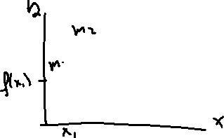

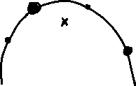

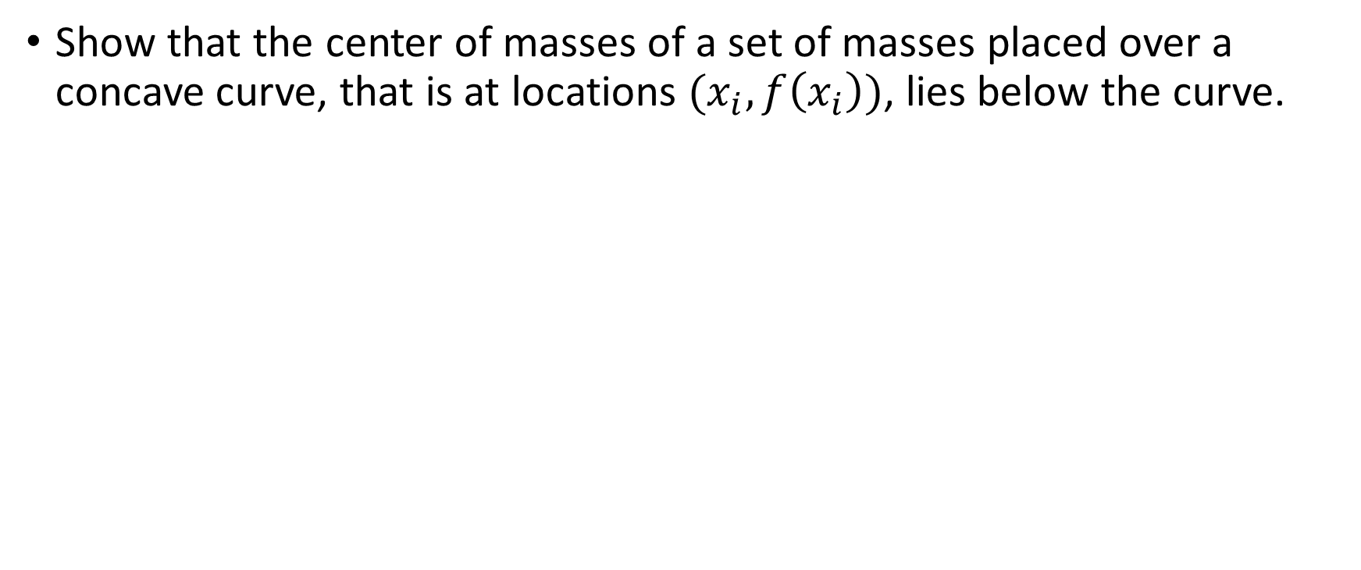
Exercise
Show that the center of masses of a set of masses placed over a concave curve, that is at locations ${(x}_{i},f\left(x_{i}\right))$, lies below the curve.

Slide 7
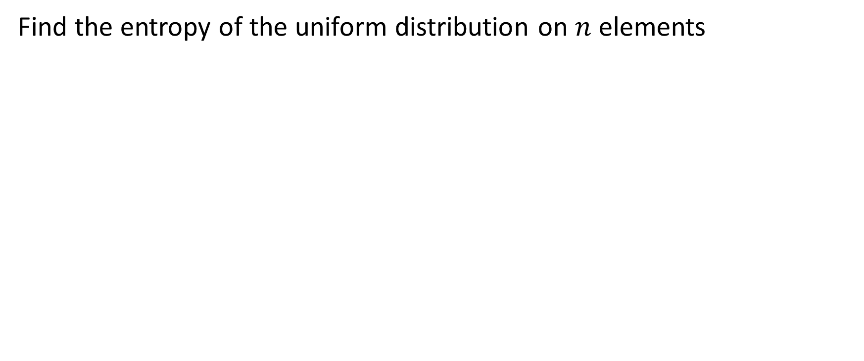


Exercise
Find the entropy of the uniform distribution on $n$ elements

Slide 8
Exercise
Show that the distribution that maximizes entropy for any alphabet size is the uniform distribution. (Hint: use Jensen’s inequality and the concavity of the log function).

Slide 9
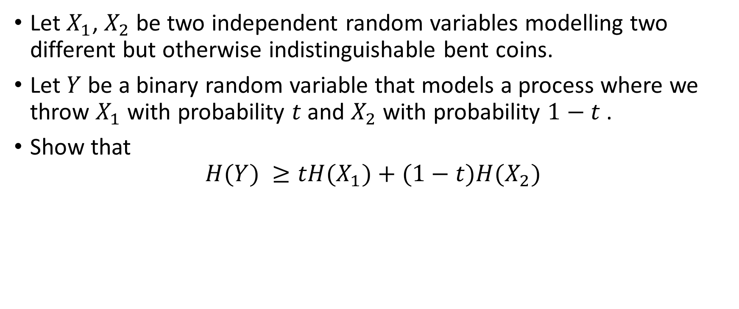
Exercise (concavity of entropy)
Let $X_{1}$, $X_{2}$ be two independent random variables modelling two different but otherwise indistinguishable bent coins.
Let $Y$ be a binary random variable that models a process where we throw $X_{1}$ with probability $t$ and $X_{2}$ with probability $1−t$ .
Show that
$$H(Y) ≥tH(X_{1})+(1−t)H(X_{2})$$

Slide 10









Slide 11
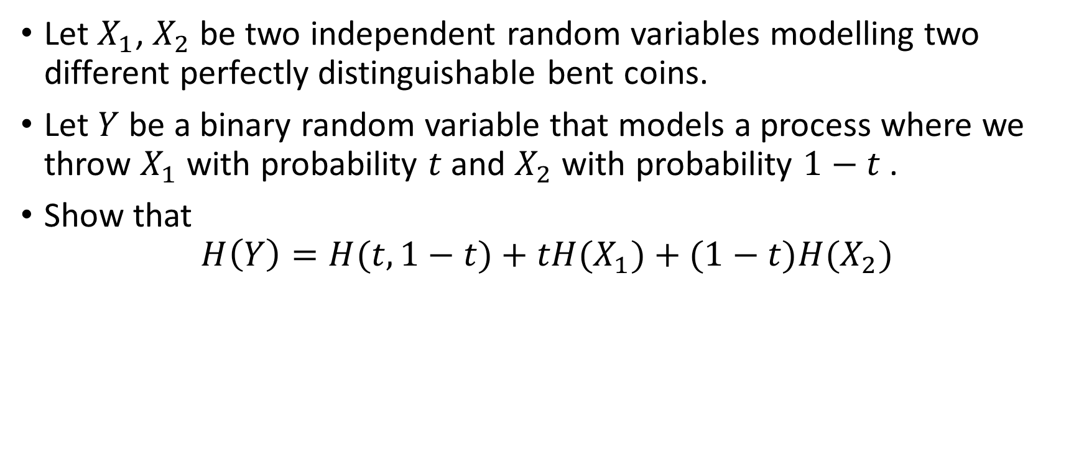
Exercise (telescopic property)
Let $X_{1}$, $X_{2}$ be two independent random variables modelling two different perfectly distinguishable bent coins.
Let $Y$ be a binary random variable that models a process where we throw $X_{1}$ with probability $t$ and $X_{2}$ with probability $1−t$ .
Show that
$$H\left(Y\right)=H(t,1−t)+tH(X_{1})+(1−t)H(X_{2})$$

Slide 12



